Slide 1
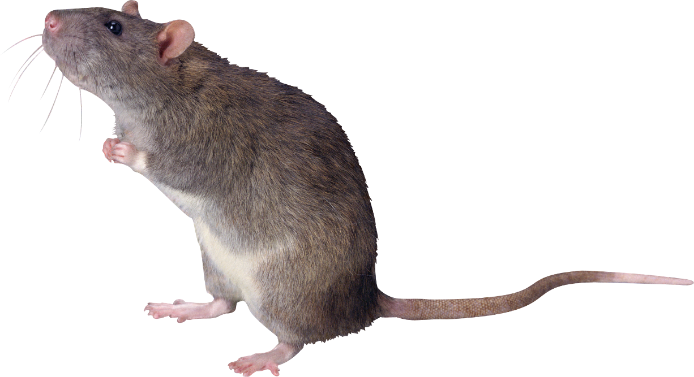
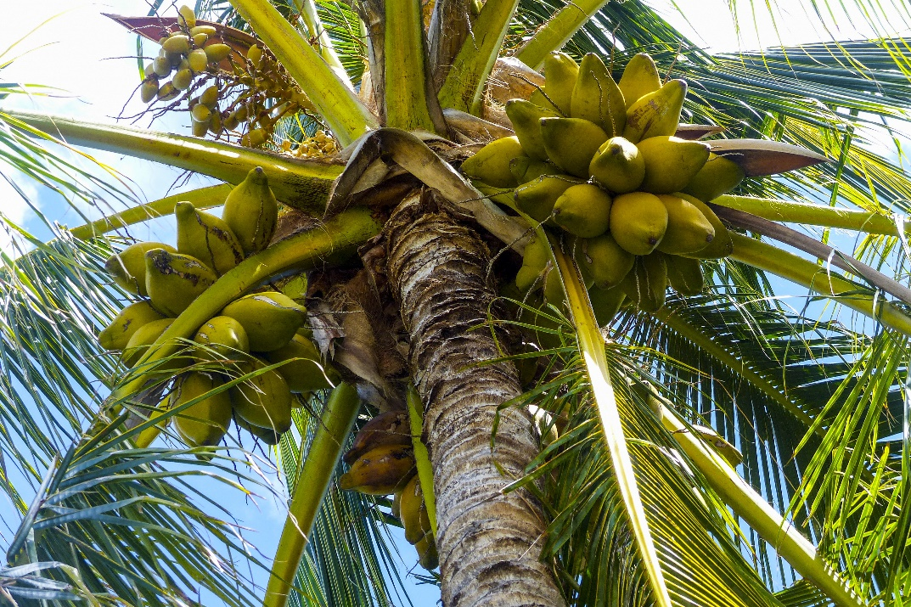
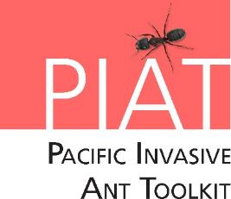


Invasive Species Lesson
Rats
Notes:
Credits: Left to right: Rat image courtesy of unnamed author - http://pngimg.com/uploads/rat_mouse/rat_mouse_PNG23553.png, License: Creative Commons 4.0 BY-NC, Photo of coconut tree courtesy of unknowned author - https://pxhere.com/en/photo/720462, the image is released free of copyrights under Creative Commons CC0.

Slide 2
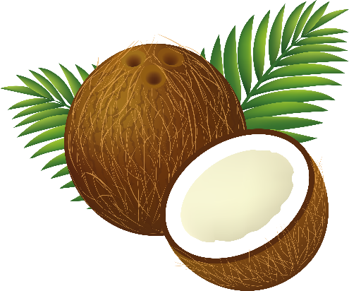
What are we going to learn today?
What are Rats.
The problems they cause to our people, our agriculture and our natural environment.
Where the rats came from and how they arrived in our country.
What can you do to stop them. – Integrated Pest Management
Notes:
Credits: Coconut illustration courtesy of unnamed author - http://pngimg.com/download/9151, License: Creative Commons 4.0 BY-NC

Slide 3
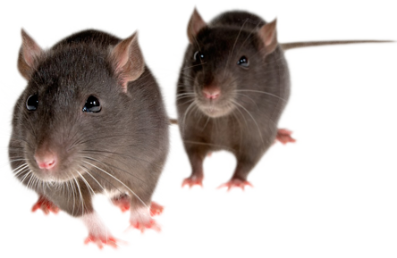
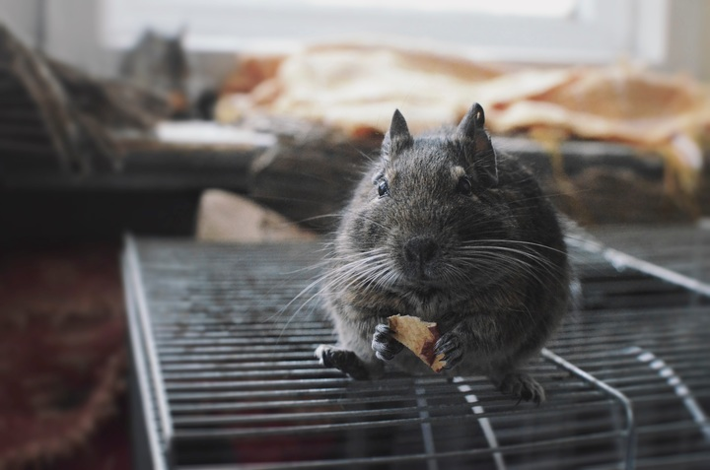
What are Rats
Rats are living things. They need air, food and water.
Rats are mammals and a major pest that damage coconut and other important crops.
There are 3 species of rats that damage crops.
Rats can breed readily when food is available and weather is suitable.
Females have litters of around 6-10 young and this can be more than twice a year.
Notes:
Credits (Top to botton) Image of rats- http://pngimg.com/download/23557, License: Creative Commons 4.0 BY-NC , Image of mouse eating on cage courtesy of unnamed author - mammal-rodent-fauna-rat-whiskers-vertebrate-115001-pxhere.com - The image is released free of copyrights under Creative Commons CC0.

Slide 4
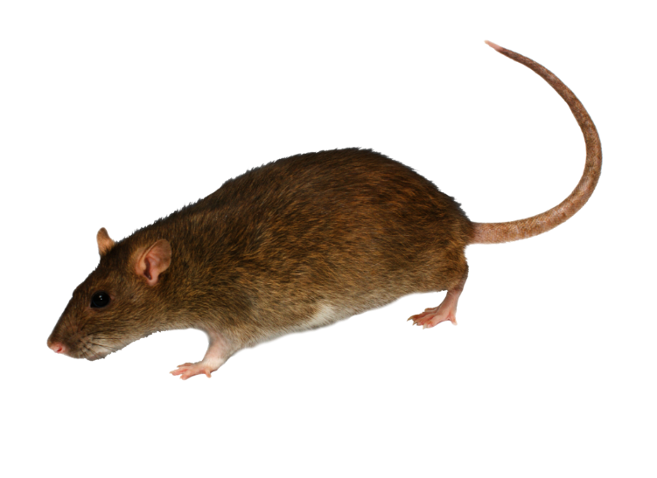
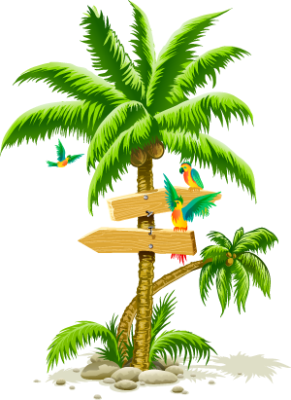
Parts of a Rat
Rats are mammals. They have fur and give birth to their young alive.
Long bare tail
Small ears
Short fur
Small black eyes
4 legged
Notes:
Credits: Rat photo courtesy of unnamed author http://pngimg.com/download/2464, License: Creative Commons 4.0 BY-NC , Coconut tree illustration courtesy of unnamed author - http://pngimg.com/download/2483, License: Creative Commons 4.0 BY-NC

Slide 5
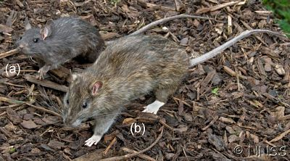
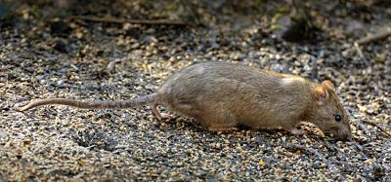
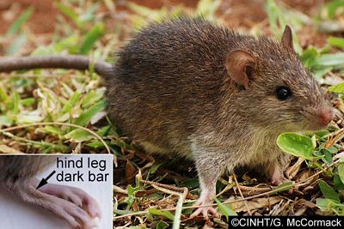
Different types of rats
The black rat (R. rattus) also has large (hairless) ears and a slim body but is larger than the Polynesian rat.
The brown rat (R. norvegicus) is the biggest of the three rats. They have small features in comparison such as their scaly tail which is shorter than their body length and they have small ears.
The Polynesian rat (R. exulans) can be identified by its pointed nose and slim body that is a red-brown to grey-brown colour with a white stomach.
Notes:
Credits: The Polynesian rat. Close up showing the dark band on the hind foot (© Gerald McCormack, Cook Islands Natural Heritage Trust), The large features and dark colour of the black rat (a) compared to the larger bodied brown rat (b) (© Crown Copyright 2009, GBNNSS), The brown rat showing its short tail and small ears in comparison to its large body size (© John Hitchmough, Flickr)

Slide 6
Where did the Rats come from?
The Polynesian rat can be found in the Pacific basin (Asia, North America and Oceania).
The black and brown rat is widespread through Asia, Africa, America (Central, North and South and the Caribbean), Europe and Oceania.
Notes:
Credits: Rat photo by unnamed author http://pngimg.com/download/2464 - Creative Commons 4.0 BY-NC, Coconut tree illustration courtesy of unnamed author - http://pngimg.com/download/2483, License: Creative Commons 4.0 BY-NC

Slide 7

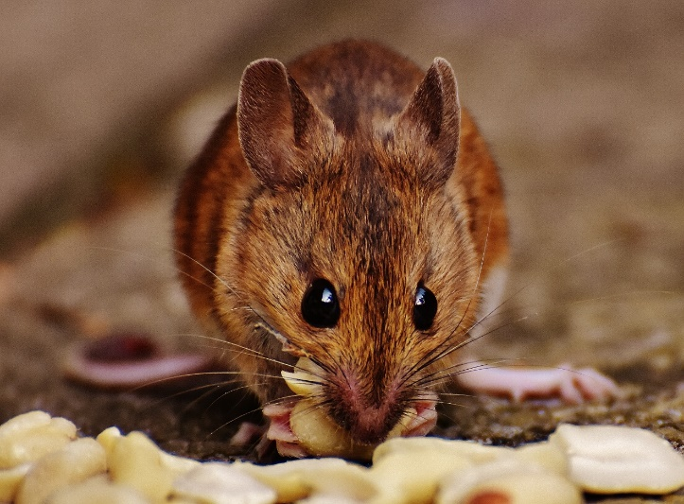
Problems caused by the Rats
Rats can damage the trunks and crown parts of the coconut tree including the fruits.
Rats can spoil coconut products by discharging their faeces and urine on them. Stored coconut food can also be eaten by rats.
Damage to the parts of the coconut tree can permanently damage the tree and increases the possibility of disease to the plant.
Notes:
Credits (Top to bottom): Photo of coconut tree by unnamed author - https://pxhere.com/en/photo/101096 - The image is released free of copyrights under Creative Commons CC0, Photo of mouse by unnamed author - https://pxhere.com/en/photo/794465 - The image is released free of copyrights under Creative Commons CC0.

Slide 8
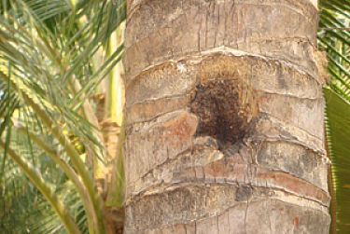
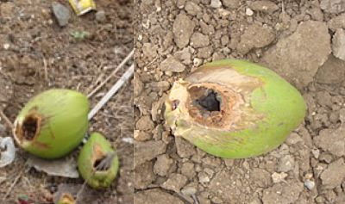
Problems caused by the Rats
The Coconut fruit is the most vulnerable plant part to rats. Coconut fruits that have fallen and have large holes are commonly the main sign of rat damage.
Gnawing damage can be also seen on the trunk of coconut trees from rats.
The rats also gnaw on the coconut flowers. This can make the palm more prone to diseases and insects.
Notes:
Credits: Large holes gnawed in to fallen nuts (© TNAU) - http://www.agritech.tnau.ac.in/expert_system/coconut/coconut/coconut_pest%20and_diseases.html#rat

Slide 9


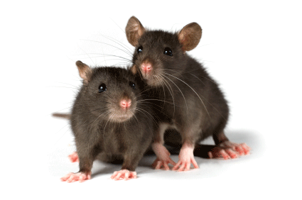
Rats are frequently found hiding on boats, ships and aircraft. Rats can also swim long distances.
Biosecurity at possible entrances must be managed.
There are countries who perform required biosecurity for docking ships and do routine inspections on ships that are in their ports. The import of rats is prohibited into and out of many Pacific islands and Australia.
Biosecurity!
Notes:
Credits: © Allan Burne – Pacific Biosecurity, Image of plane courtesy of satit_srihin at FreeDigitalPhotos.net, Rats image courtesy of unnamed author - http://pngimg.com/uploads/rat_mouse/rat_mouse_PNG2457.png, License: Creative Commons 4.0 BY-NC

Slide 10
Integrated Pest Management
Integrated Pest Management (IPM)
Cultural Approach | Natural Approach | Chemical Approach
Rats are commonly introduced from and found around human populations. Therefore, keeping environments clean and tidy and storing food resources tightly can help reduce rat populations. | Trapping is a great option to catch all species of rats and help with identifying what species is present. Snap traps and live traps can be used. More than 3 nights of trapping should be completed as the brown and black rat (dominant species) are generally caught first then the Polynesian rat the remaining nights. | Baiting with pesticides or rodenticides is commonly used as a control or eradication tool.
New sighting of rats should be reported immediately to the nearest wildlife authority or relevant government department. Predators should never be introduced to control rats. Removing one species of rat can make areas more vulnerable to other species as it reduces their competition. Therefore, all three rat species should be focused on equally.
Notes:
Note:
New sighting of rats should be reported immediately to the nearest wildlife authority or relevant government department. Predators should never be introduced to control rats. Removing one species of rat can make areas more vulnerable to other species as it reduces their competition. Therefore, all three rat species should be focused on equally.

Slide 11
Activity Time!
You are the Experts! Discussion
Notes:
Credits: Rats image courtesy of unnamed author - http://pngimg.com/uploads/rat_mouse/rat_mouse_PNG2457.png, License: Creative Commons 4.0 BY-NC , Coconut tree illustration courtesy of unnamed author - http://pngimg.com/download/2483, License: Creative Commons 4.0 BY-NC

Slide 12

You are the Experts! Discussion
You will be grouped into groups of 3.
Each group will be give 3 fact sheets (Annexes 1, 2 or 3), each student will be given 1.
You will have 10mins to read the fact sheet and record important details for sharing.
You can record important details on the fact sheet.
At the end of 10mins, You will be given 2 mins to share the important details of your fact sheet in your group.
Notes:
Credits: Coconut illustration courtesy of unnamed author - http://pngimg.com/download/9151, License: Creative Commons 4.0 BY-NC
In the event of extra students, the teacher can assign 2 students to 1 factsheet.

Slide 13
Activity Time!
You are the Experts! Sharing
Notes:
Credits: Rats image courtesy of unnamed author - http://pngimg.com/uploads/rat_mouse/rat_mouse_PNG2457.png, License: Creative Commons 4.0 BY-NC , Coconut tree illustration courtesy of unnamed author - http://pngimg.com/download/2483, License: Creative Commons 4.0 BY-NC
Teacher will get the different groups to share 1 key point from each approach. Teacher can record the key points on the board or a piece of paper to put up in the classroom.

Slide 14
What we have learnt today
Rats are living things. They need air, food and water.
Rats are a mammals and a major pest that damage coconut and other important crops.
Both the Polynesian rat and the black and brown rat can be found in the pacific.
Rats can damage the trunks and crown parts of the coconut tree including the fruits.
Rats can spoil coconut products by discharging their faeces and urine on them.
The integrated pest management approach involves cultural, natural and chemical approaches.
Notes:
Credits: Coconut illustration courtesy of unnamed author - http://pngimg.com/download/9151, License: Creative Commons 4.0 BY-NC

Slide 15
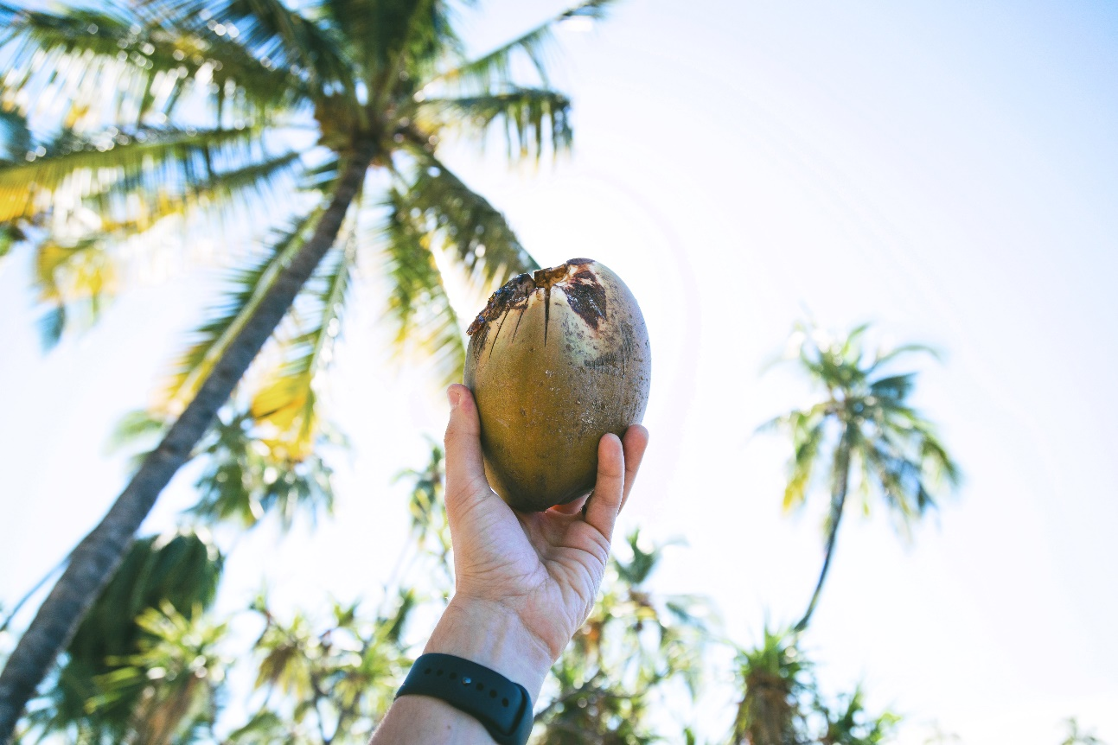
See you next time!
Notes:
Credits: Photo of man holding coconut by unnamed author - https://pxhere.com/en/photo/1391922- The image is released free of copyrights under Creative Commons CC0.

Slide 16
References
Coconut Pests and Diseases Toolkit 2018 - http://www.pacificbiosecurity.org/coconut-toolkit-2018.html
Rats information factsheet - http://coconutpests.org//pests-and-diseases-of-coconut/rats

Slide 17
Image Credits
Slide 1: Rat image courtesy of unnamed author - http://pngimg.com/uploads/rat_mouse/rat_mouse_PNG23553.png, License: Creative Commons 4.0 BY-NC, Photo of coconut tree courtesy of unknowned author - https://pxhere.com/en/photo/720462, the image is released free of copyrights under Creative Commons CC0.
Slide 2, 12, 14: Coconut illustration courtesy of unnamed author - http://pngimg.com/download/9151, License: Creative Commons 4.0 BY-NC
Slide 3: Image of rats- http://pngimg.com/download/23557, License: Creative Commons 4.0 BY-NC , Image of mouse eating on cage courtesy of unnamed author - mammal-rodent-fauna-rat-whiskers-vertebrate-115001-pxhere.com - The image is released free of copyrights under Creative Commons CC0.
Slide 4: Rat photo courtesy of unnamed author http://pngimg.com/download/2464, License: Creative Commons 4.0 BY-NC , Coconut tree illustration courtesy of unnamed author - http://pngimg.com/download/2483, License: Creative Commons 4.0 BY-NC
Slide 5: The Polynesian rat. Close up showing the dark band on the hind foot (© Gerald McCormack, Cook Islands Natural Heritage Trust), The large features and dark colour of the black rat (a) compared to the larger bodied brown rat (b) (© Crown Copyright 2009, GBNNSS), The brown rat showing its short tail and small ears in comparison to its large body size (© John Hitchmough, Flickr)
Slide 6: Rat photo by unnamed author http://pngimg.com/download/2464 - Creative Commons 4.0 BY-NC, Coconut tree illustration courtesy of unnamed author - http://pngimg.com/download/2483, License: Creative Commons 4.0 BY-NC
Slide 7: Photo of coconut tree by unnamed author - https://pxhere.com/en/photo/101096 - The image is released free of copyrights under Creative Commons CC0, Photo of mouse by unnamed author - https://pxhere.com/en/photo/794465 - The image is released free of copyrights under Creative Commons CC0.
Slide 8: Large holes gnawed in to fallen nuts (© TNAU) - http://www.agritech.tnau.ac.in/expert_system/coconut/coconut/coconut_pest%20and_diseases.html#rat
Slide 9: Image of ship and harbour © Allan Burne – Pacific Biosecurity, Image of plane courtesy of satit_srihin at FreeDigitalPhotos.net, Rats image courtesy of unnamed author - http://pngimg.com/uploads/rat_mouse/rat_mouse_PNG2457.png, License: Creative Commons 4.0 BY-NC
Slide 11 and 13: Rats image courtesy of unnamed author - http://pngimg.com/uploads/rat_mouse/rat_mouse_PNG2457.png, License: Creative Commons 4.0 BY-NC , Coconut tree illustration courtesy of unnamed author - http://pngimg.com/download/2483, License: Creative Commons 4.0 BY-NC
Slide 19: Image of man holding coconut by unnamed author - https://pxhere.com/en/photo/1391922- The image is released free of copyrights under Creative Commons CC0.

